Slide 1
Gross Motor Milestones and Recommended PT Activities
National Children’s Center
Early Learning Center
Emily Ribaric, PT, DPT, PCS
Physical Therapist

Slide 2
0-6 MONTHS

Slide 3
0-6 MONTHS
MILESTONES:
Tummy Time Progression
Turns head side to side
Lifts head briefly
Pushes up onto elbows (3-4 months) A
Pushes up onto hands (4-5 months) E
ACTIVITIES:
During free play, roll the child onto their tummy to hold position for as long as they tolerate (3-4 times a day)
Use a mirror or toys in front to keep their attention C,D
Place a towel roll or small pillow under arm pits to make it easier B,C
RED FLAGS:
Only turns head toward one direction
Unable to keep head lifted for more than a minute by 4 months

Slide 4
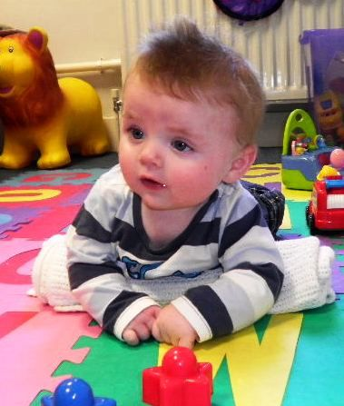
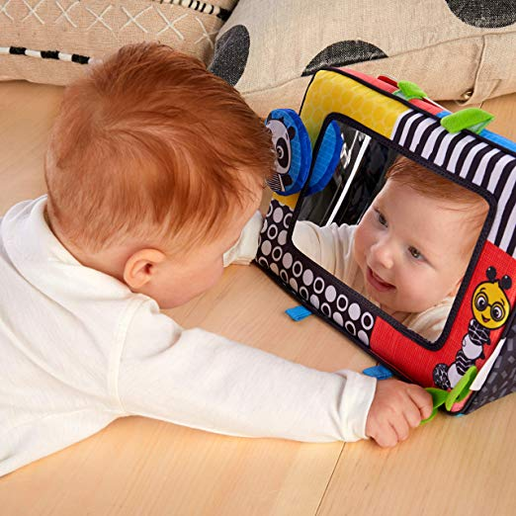
0-6 MONTHS
B
C
A
E
D

Slide 5
0-6 MONTHS
MILESTONES:
Head/Trunk Control:
Holds head upright and steady when being held
Tucks chin and lifts head when being pulled from back to sitting (4 months) A
Holds onto both feet and brings to mouth when lying on back (6 months) C,D
ACTIVITIES:
Practice “baby sit-ups” by pulling the child to sitting, then slowly help lower them back down A
Encourage trunk strengthening, by helping the child grasp and hold onto feet D
RED FLAGS:
Unable to keep head steady when being held
Head lags backward when being pulled to sitting

Slide 6
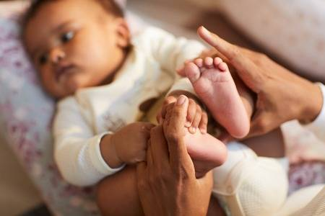
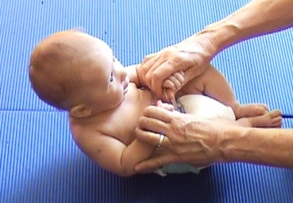
0-6 MONTHS
A
B
D
C

Slide 7
0-6 MONTHS
MILESTONES:
Rolling progression
Rolls from back to side
Rolls from stomach to back (4-5 months)
Rolls from back to stomach (6 months) A
ACTIVITIES:
When putting the child on their stomach, practice rolling through side
Dangle various toys above and to the side for them to reach across body B,C
Place a mirror on one side of them
RED FLAGS:
Only rolls toward one direction and over one side
Does not lift head while rolling

Slide 8
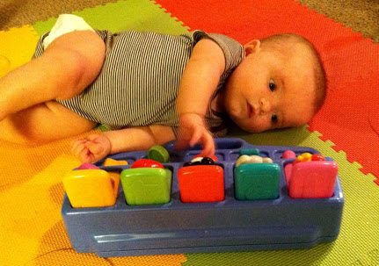
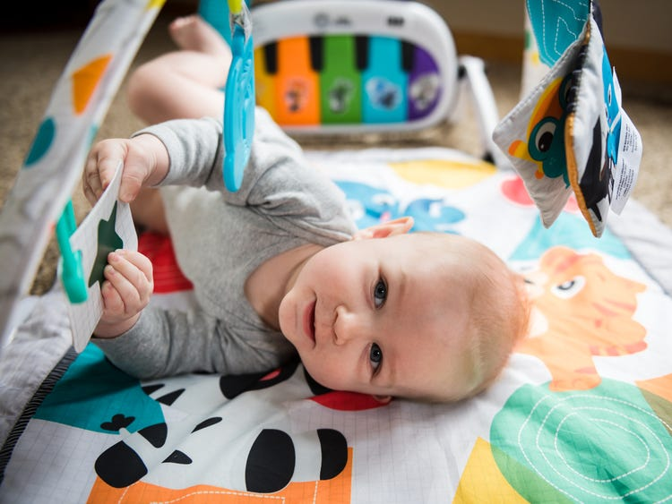
0-6 MONTHS
A
C
B

Slide 9
0-6 MONTHS
MILESTONE:
Supported sitting – stays in sitting with support around hips (5 months)
ACTIVITIES:
Support the child in sitting with your hands next to their hips or on their trunk B
Place baby in sitting with support from pillows around their hips (stay close for safety) A,B
Keep their attention with songs, a mirror, or different dangling toys B
RED FLAGS:
Unable to keep head lifted
Head is tilted toward one side
Back stays rounded
Arches or extends backward when placed in sitting

Slide 10
0-6 MONTHS
A
C
B

Slide 11
6-12 MONTHS

Slide 12
6-12 MONTHS
MILESTONES:
Sitting Progression
Sits with support around trunk
Sits with support on hips
Sits without support; hands propped on the floor (7 months) A
Sits without support and reaches forward and to the side B
Transfers from their stomach or hands-and-knees to sitting (8-9 months) C
ACTIVITIES:
Practice sitting with support and having the child reach for toys around them
Help the child sit while placing their hands on the ground (sing songs in front to keep their attention)
Place toys around the child to encourage them to reach for toys D
Help them move into sitting by helping them move diagonally with your hand on their hip
RED FLAGS:
Unable to hold position by themselves without support
Always transfers to sitting through one side
Sits in “W-sit” position

Slide 13
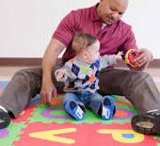
6-12 MONTHS
C
D
A
B

Slide 14
6-12 MONTHS
MILESTONES:
Crawling Progression
Pivots on stomach by moving right and left to get a toy (7 months)
Crawls forward on stomach (8 months) A
Moves into hands and knees position and rocks forward and backward
“Creeps” forward on their hands and knees (9 months) B,C
ACTIVITIES:
Place toys all around the child to encourage movement toward the sides and forward
Help them get on their hands and knees, and with your hands on their hips, rock them forward and backward, “dancing” to music
RED FLAGS:
Not demonstrating any signs of mobility or desire to get toys
“Bunny Hops” forward by moving arms then both legs at the same time

Slide 15
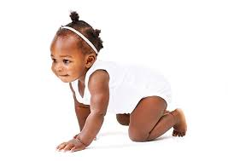
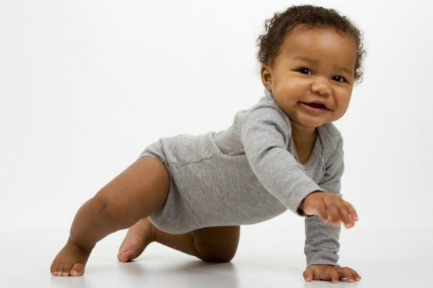
6-12 MONTHS
C
A
B
D

Slide 16
6-12 MONTHS
MILESTONES:
Standing Progression
Stands with hands on support surface A
Uses arms to pull up to standing at a support surface (9 months) B
“Cruises” side to side with hands on support surface (10 months) C
Lowers self down to sitting from surface with control (10 months)
ACTIVITIES:
Place toys on a surface, and help the child move onto their knees
Help child pull to stand by placing one foot forward on the ground and help at their hips to move to standing (right and left) D
Help them move sideways by shifting their weight onto one leg and moving the opposite leg toward the side (right and left)
RED FLAGS:
Only uses one leg to move into standing
Always stands on tip toes when placed or after pulling to stand

Slide 17
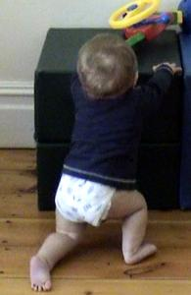
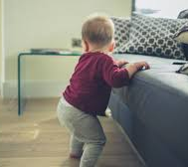
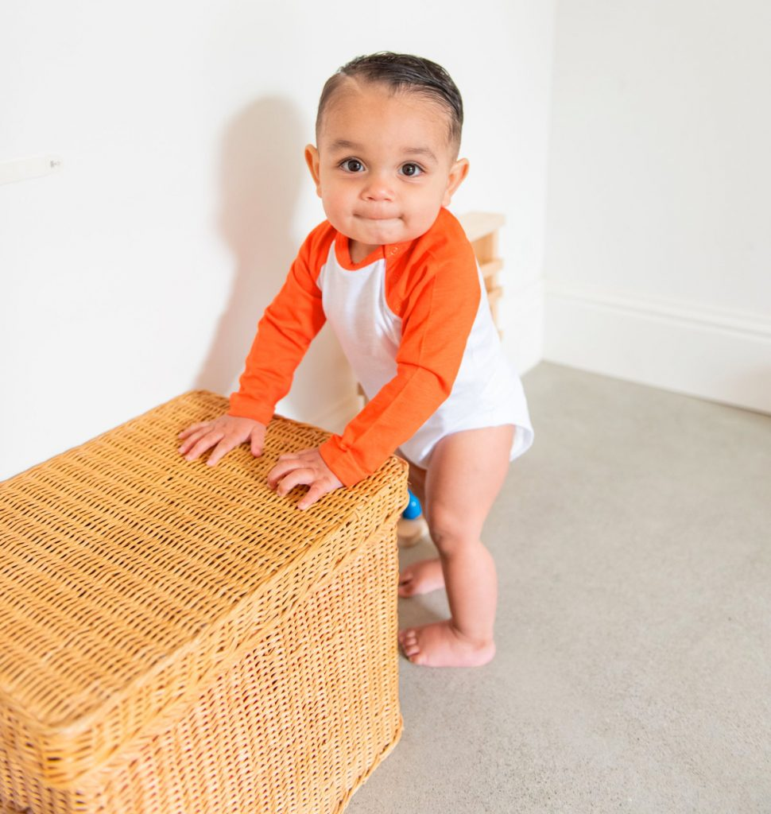
6-12 MONTHS
D
A
C
B

Slide 18
6-12 MONTHS
MILESTONES:
Walking Progression
Pivots from one surface to another with only 1 hand on surface (11 months) A,B
Takes steps with 1-2 hands held (11 months) C,D,E
Takes at least 5 steps alone (12 months) F
ACTIVITIES:
Encourage the child to walk with various amount of support
Around trunk
Both hands held or on push toy B
With one hand held
RED FLAGS:
Refuses to put weight through feet

Slide 19
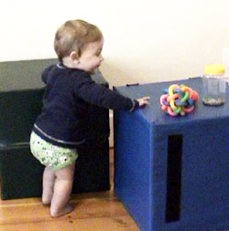
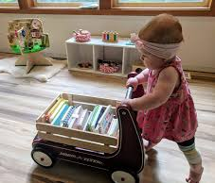
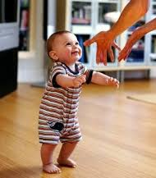
6-12 MONTHS
A
B
C
E
D
F

Slide 20
12-18 MONTHS

Slide 21
12-18 MONTHS
MILESTONES:
Walking Progression
Walks without support for at least 10 feet – wide base of support, hands up (12 months) A,B
Stands up from the floor independently (14 months) C,D
Walks independently – narrow base of support, heel-toe (14 months) E
Squats down to pick up toy from ground, returns to standing and takes steps (14 months) F,G
ACTIVITIES:
Practice having the child walk to you from various distances
Give the child support at hips to help them squat down to pick up toys
RED FLAGS:
One or both feet turn excessively out or in
Refuses to weight bear or take steps with/without support

Slide 22
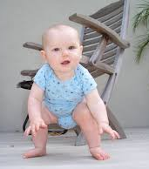
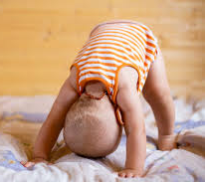
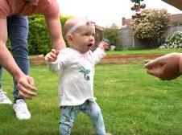
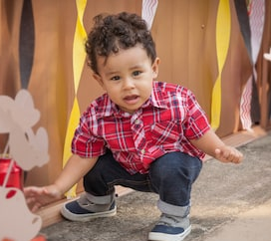
12-18 MONTHS
D
C
A
B
E
F
G

Slide 23
12-18 MONTHS
MILESTONES:
Stair Progression
Crawls up stairs on hands and knees (13 months) A,B
Crawls backward down stairs on hands and knees (17 months) C
Walks up and down stairs placing both feet on steps and holding onto railing for support (17 months) D,E
ACTIVITIES:
Encourage the child to crawl onto a step or foam block using right and left leg
Practice going up and down steps while the child holds your hand and railing (encourage both right and left leg to lead) D
**Always help the child from below**
RED FLAGS:
Only uses one leg (left or right) when going up or down stairs

Slide 24
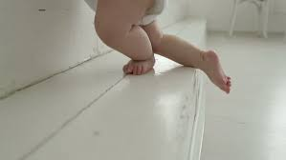
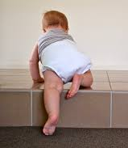
12-18 MONTHS
E
C
B
D
A

Slide 25
12-18 MONTHS
MILESTONES:
Balance Tasks
Holds “tall kneeling” position with bottom off feet for at least 5 seconds (13 months) A
Throws a ball without losing balance (14 months) B
Kicks a ball without losing balance (18 months) C
ACTIVITIES:
During circle times, having all the children sing while kneeling
Play with child in kneeling, encourage them to reach up for toy A
RED FLAGS:
Unable to keep balance in these positions while playing
Only uses one hand or foot to throw or kick

Slide 26
12-18 MONTHS
A
B
C

Slide 27
18-24 MONTHS

Slide 28
18-24 MONTHS
MILESTONES
Runs A
Sidesteps
Walks backwards C,D
Walks up steps without support B
ACTIVITIES
Hold the child’s hands, and do sidesteps and backwards walking together while singing songs
Give the child one finger support to give them increased confidence walking up stairs
Give the child a “pull toy” with a string to practice walking backwards D
RED FLAGS:
Loses balance and falls frequently

Slide 29
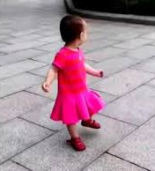
18-24 MONTHS
B
C
A
D

Slide 30
18-24 MONTHS
MILESTONES
Jumps with two-footed take-off and landing
Up 2 inches A,C
Forward 4 inches B
Off small step
ACTIVITIES
Encourage the child to make a “boom” sound when jumping
Place stickers on the floor for the child to jump onto B
When practicing jumping at first, hold their hands to help
RED FLAGS:
One foot always leads when jumping

Slide 31
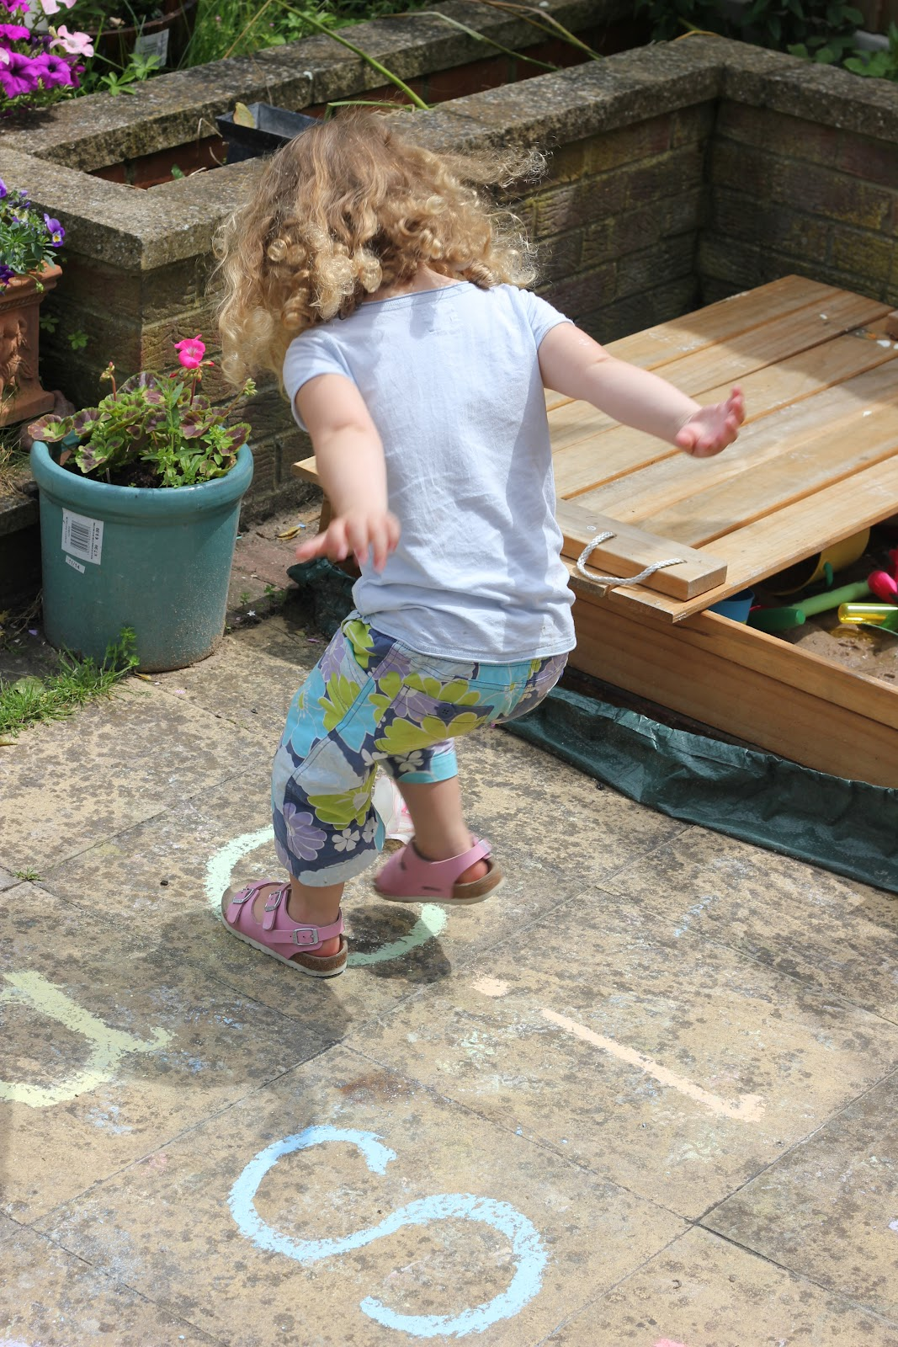
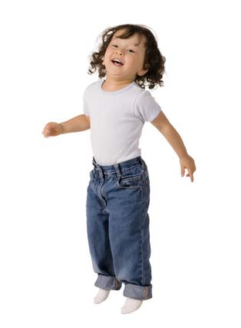
18-24 MONTHS
A
B
C

Slide 32
2-3 YEARS

Slide 33
2-3 YEARS
MILESTONES
Runs with good arm swing A
Stands on one leg for 3 seconds B
Walks on tiptoes
Jumps forward 2 feet C
Catches a ball D
ACTIVITIES
Practice “Animal Walks”
Stand on one leg like a flamingo B
Walk on tiptoes, quiet like a mouse
Jump like a frog between “lily-pads” (circles on the floor) C
During circle time:
Practice tossing a ball back and forth D
Sing a song while standing on one foot (left and right) B
RED FLAGS:
Trips and falls often
Does not attempt to copy requested tasks or activities
Only walks on tip-toes

Slide 34
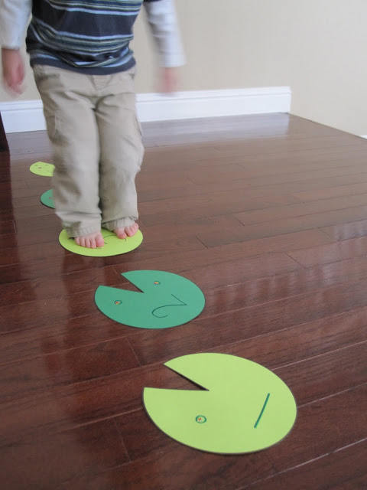
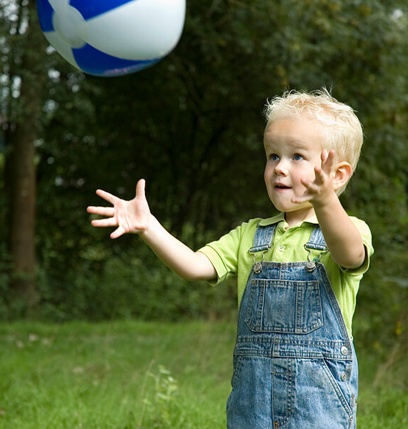
2-3 YEARS
A
C
B
D

Slide 35
2-3 YEARS
MILESTONES
Walks down steps without support (can place both feet on each step) A
Walks up steps with one foot on each stair (with support) B
ACTIVITIES
Give the child something to hold onto with both hands (ball or toy) so they do not hold onto railing
Count with the child “One, Two! One, Two!” or “Left, Right! Left, Right!” to encourage them to place only one foot on each step
Place different colored stickers on the steps or the child’s feet and cue them to use their “red” foot or “blue” foot
RED FLAGS:
Always uses the same leg to go up or down steps

Slide 36
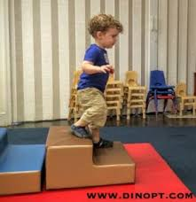
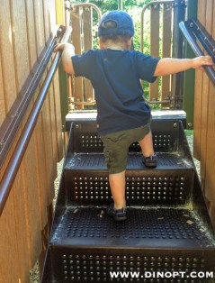
2-3 YEARS
A
B

Slide 37
3-4 YEARS

Slide 38
3-4 YEARS
MILESTONES
Gallops A
Hops on one foot (left and right) B
Stands on tip toes for 5 seconds C
ACTIVITIES
Do different “Animal Walks”
Gallop like a horse
Hop on one leg like a kangaroo
Jump like a frog
Walk like a crab
Stand on tip toes and be tall like a giraffe
Play “Follow the Leader” with different activities
RED FLAGS:
Unable to jump or balance

Slide 39
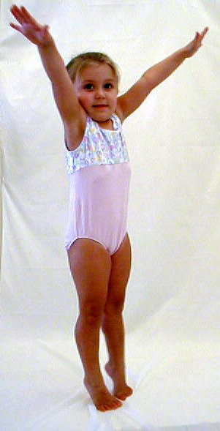
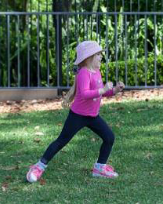
3-4 YEARS
A
B
C

Slide 40
3-4 YEARS
MILESTONES
Walks along a line without stepping off A
Stands on one foot for 5 seconds B
Walks up and down stairs with one foot placed on each step, with no support C
ACTIVITIES
Sing a song while standing on one leg (left and right)
Place one foot on a step, block, or ball while they are playing with a puzzle or other toy to increase their balance
Place tape in a line along the floor for a maze and have the children walk along it without stepping off
RED FLAGS:
Has a preference to use one leg for stairs, hopping, galloping, or standing on one leg

Slide 41
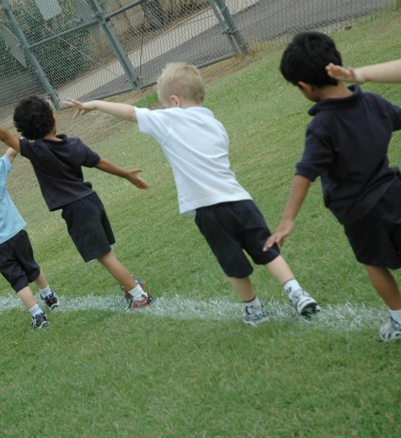
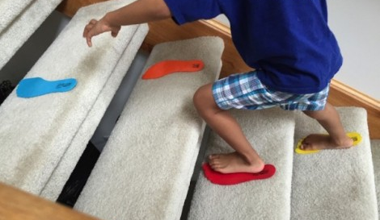
3-4 YEARS
A
B
C

Slide 42
4-5 YEARS

Slide 43
4-5 YEARS
MILESTONES
Walks along a balance beam without stepping off A
Stands on one foot for 10 seconds B
ACTIVITIES
Cosmic Kids Yoga on YouTube
Yoga poses for balance and calming
“Tree” pose on one leg
“Three-legged dog” on one leg
Stand with feet on an imaginary tightrope
RED FLAGS:
Unable to copy different balance poses or tasks

Slide 44
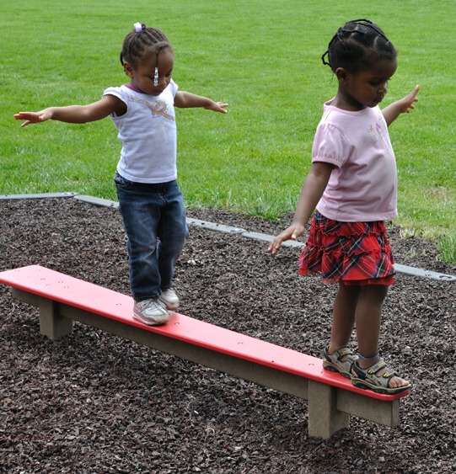
4-5 YEARS
B
A

Slide 45
4-5 YEARS
MILESTONES
Jumps with two-footed take-off and landing: A
Over string
Sideways over line
Off bench B
180 degree turn
Skips forward using alternating feet with opposite arm swing C
Hops forward on one foot (left and right) A
ACTIVITIES
Do different “Animal Walks”
See cards
Play “Follow the Leader” or “Simon Says” to practice copying
RED FLAGS:
Has a preference to use on leg for stairs, hopping, galloping, standing on one leg
Unable to jump with two-footed take-off and landing

Slide 46
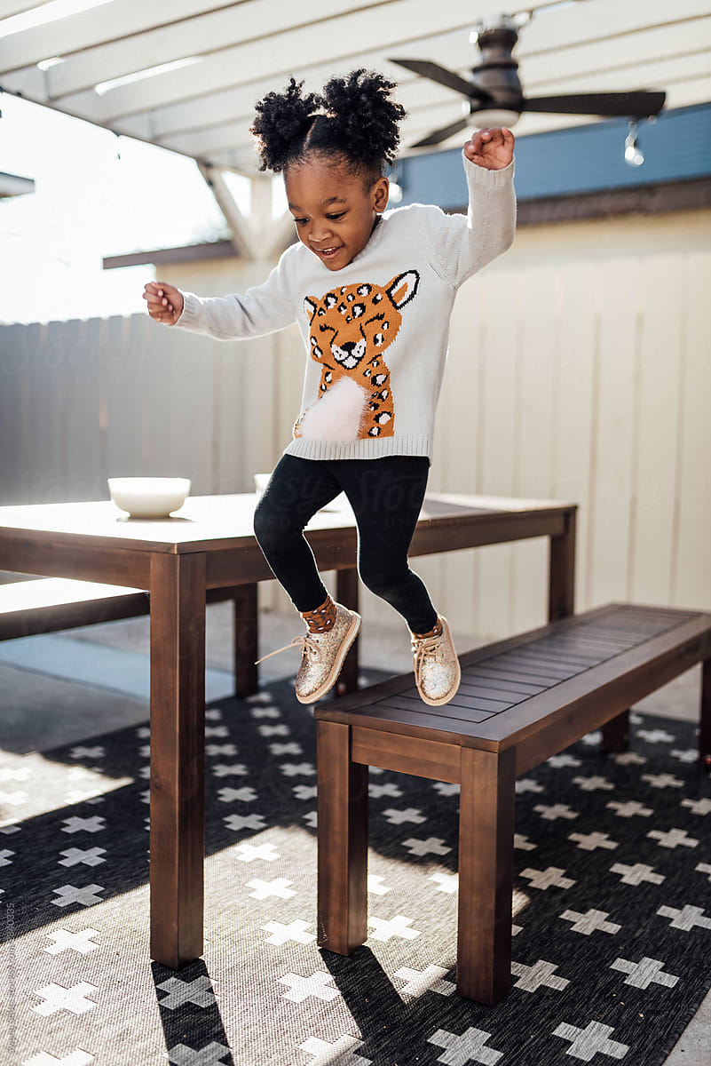
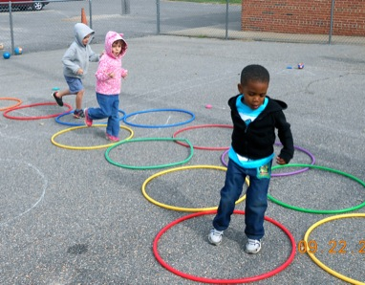
4-5 YEARS
A
B
C

Slide 47
4-5 YEARS
MILESTONES
Catches and throws a small ball A,B
Throws a ball and hits a target A
ACTIVITIES
Sing “Hot Potato” while having children toss a bean bag back and forth
Throw bean bags or small balls into a bucket, seeing who can get the most in B
RED FLAGS:
Unable to catch ball or throw near target (may indicate vision problems)

Slide 48
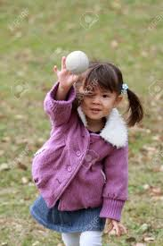
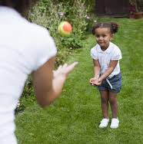
4-5 YEARS
B
C
A

Slide 49
RESOURCES
www.zerotothree.org
www.cdc.gov
Peabody Motor Development Chart
IMAGES:
https://www.pregnancybirthbaby.org.au/tummy-time
https://www.pinterest.com/pin/196680708697370952/
https://www.healthline.com/health/parenting/when-do-babies-start-walking
https://www.pinterest.com/pin/75576099981049458/
https://kids.britannica.com/students/assembly/view/233380
https://www.youtube.com/watch?v=9b09N34yl00
https://www.mosaicrehabmt.com/gross-motor-milestone-series-kneeling/
https://www.greentoys.com/products/dune-buggy-pull-toy
https://snaphappymom.com/flora-flamingo/
https://childmuscleweakness.org/materials-for-families/
https://parenting.firstcry.com/articles/gross-motor-developmental-milestone-jumping/
https://quatr.us/math/commutative-project-chalk-number-line.htm
http://adventurouschild.com/product/fitness/balance-beam-graduated/
https://www.theepochtimes.com/why-skipping-is-better-than-running_2920323.html
https://teachpreschool.org/2014/09/30/bean-bag-bucket-toss/
https://www.littlelifelonglearners.com/2018/12/baby-play-2-months.html/tummy-time-in-front-of-the-mirror/
https://www.chicagopediatrictherapyandwellness.com/blog/tummy-time/
https://www.google.com/url?sa=i&url=https%3A%2F%2Fwww.pinterest.com.au%2Fpin%2F32158584811441997%2F&psig=AOvVaw2qGIY1IsjC7gmM9XozEP2W&ust=1590677149398000&source=images&cd=vfe&ved=0CAIQjRxqFwoTCLjtooSl1OkCFQAAAAAdAAAAABAW

Slide 50
RESOURCES
IMAGES continued:
https://tomt.skillsforaction.com/dev/pull-to-sit
https://www.123rf.com/stock-photo/black_newborn.html?sti=mvw53g0crng6d7v7py|
http://mamaot.com/10-tips-for-helping-babies-learn-to-roll/
http://mamaot.com/exersaucers-the-good-the-bad-the-better/
http://www.candokiddo.com/news/2014/12/2/better-than-a-bumbo-5-ways-to-support-a-wobbly-sitter
https://momwoot.com/baby-army-crawl/
https://www.howwemontessori.com/how-we-montessori/2012/02/pulling-to-standing-creating-an-environment-that-supports-movement.html
https://fittingchildrenshoes.com/what-shoes-help-a-baby-walk-allow-your-baby-to-take-those-first-steps-with-confidence
https://blog.dinopt.com/sitting-101-tips-and-tricks/cherrick-5461/
http://developmentalgym.com/infant-up-into-standing
https://www.montessoriinreallife.com/home/2018/8/7/cruising-through-a-year-with-some-bumps
https://www.youtube.com/watch?v=ArFlmbvv1qs
https://www.verywellfamily.com/understanding-the-stepping-reflex-in-newborns-290103
https://www.romper.com/p/why-do-toddlers-stand-on-their-heads-its-more-important-for-development-than-you-might-think-11842703

Slide 51
RESOURCES
IMAGES continued:
https://www.guavafamily.com/pages/when-to-start-tummy-time
https://www.123rf.com/photo_13973779_cute-baby-girl-in-pink-bodysuit-playing-with-soft-toy-squatting-on-floor.html
https://www.shutterstock.com/video/clip-8666638-baby-crawling-on-stairs
https://www.pinterest.com/pin/516577019733942562/
https://montikids.com/montessori/why-does-my-toddler-keep-throwing-things/
https://www.gettyimages.com/photos/baby-kicking-ball
https://www.babycenter.in/a556921/running-and-jumping-toddler-development
https://theimaginationtree.com/noisy-letter-jump-phonics-game/
https://www.toddlerapproved.com/2011/05/lily-pad-hop.html
https://encrypted-tbn0.gstatic.com/images?q=tbn%3AANd9GcQLCvyvganLouFCz82FcqtIZVihHvCytE9qNRwrv9wnLKNO9L-Q&usqp=CAU
https://www.physiocomestoyou.co.uk/blog/will-child-learn-jump/
https://www.pinterest.com/pin/292522938272128302/
https://blog.dinopt.com/stair-climbing-tips/
https://www.wslhd.health.nsw.gov.au/Healthy-Children/Our-Programs/Munch-Move/Fundamental-Movement-Skills
https://in.pinterest.com/pin/673006738043771348/
https://www.topendsports.com/testing/tests/balance-stork.htm
https://www.verywellfamily.com/physical-activity-for-preschoolers-1257162

Slide 52
RESOURCES
IMAGES continued:

